Slide 1
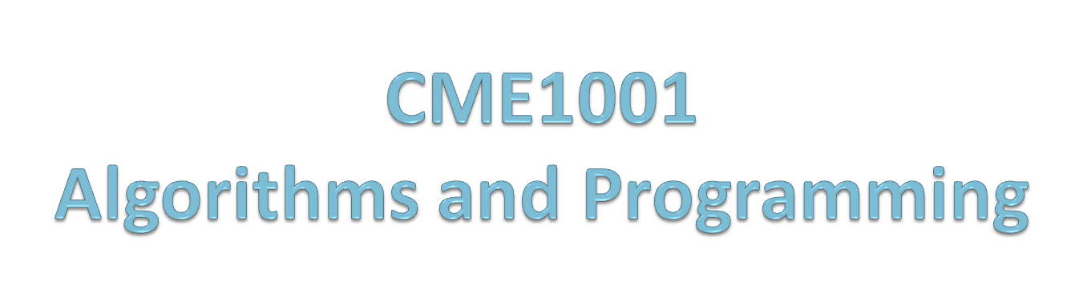
Conditional Statements (Part 2)
Prof. Dr. Alp KUT
Asst. Prof. Dr. Derya BİRANT

Slide 2
OUTLINE
Conditional Statements
  IF Statement
  IF / ELSE Statement
  Nested IF / ELSE Statements
  Switch Case
Examples

Slide 3
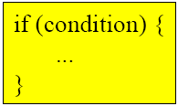
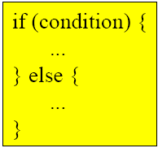
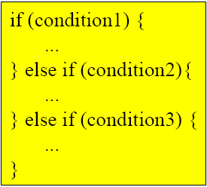
IF – IF/ELSE – NESTED IF/ELSE Statements
IF - performs an action if the condition is true
do nothing if the condition is false
IF / ELSE - performs action1 if the condition is true
performs action2 if the condition is false
NESTED - performs action1 if the condition1 is true
performs action2 if the condition2 is true
performs action3 if the condition3 is true
...

Slide 4
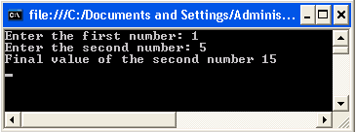
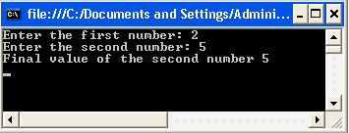
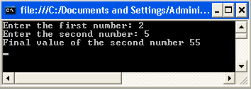
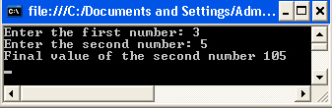
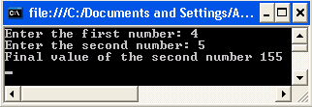
IF – IF/ELSE – NESTED IF Statements
int x, y;
Console.Write("Enter the first number: ");
x = Convert.ToInt32(Console.ReadLine());
Console.Write("Enter the second number: ");
y = Convert.ToInt32(Console.ReadLine());
if (x == 1)
y = y + 10;
if (x == 1)
y = y + 10;
else
y = y + 50;
if (x == 1)
y = y + 10;
else if (x == 2)
y = y + 50;
else if (x == 3)
y = y + 100;
else
y = y + 150;
Console.WriteLine(“Final value of
the second number " + y);
Console.WriteLine(“Final value of
the second number ” + y);
Console.WriteLine(“Final value of
the second number ” + y);

Slide 5
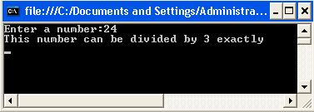
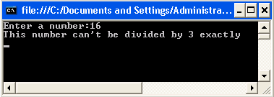
Example
Determine whether a given number can be divided by 3 exactly or not.
int number;
Console.Write("Enter a number:");
number = Convert.ToInt32(Console.ReadLine());
if (number % 3 == 0)
Console.WriteLine("This number can be divided by 3 exactly");
else
Console.WriteLine("This number can't be divided by 3 exactly");

Slide 6
Switch Case
Handles multiple selections
The first true case statement is executed
It is an alternate to the NESTED IF / ELSE statement
switch(x) {
case 1:
action1
break;
case 2:
action2
break;
case 3:
action2
break;
default:
action3
}
If (x == 1)
action1
else if (x == 2)
action2
else if (x == 3)
action3
else
action4

Slide 7
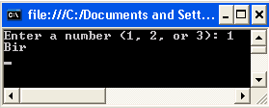

Switch Case – IF/ELSE Example
int number;
Console.Write("Enter a number (1, 2, or 3):");
number = Convert.ToInt32(Console.ReadLine());
switch (number)
{
case 1:
Console.WriteLine("Bir");
break;
case 2:
Console.WriteLine("İki");
break;
case 3:
Console.WriteLine("Üç");
break;
default:
Console.WriteLine("Wrong number");
break;
}
int number;
Console.Write("Enter a number (1, 2, or 3): ");
number = Convert.ToInt32(Console.ReadLine());
if (number == 1)
Console.WriteLine("Bir");
else if (number == 2)
Console.WriteLine("İki");
else if (number == 3)
Console.WriteLine("Üç");
else
Console.WriteLine("Wrong number");

Slide 8
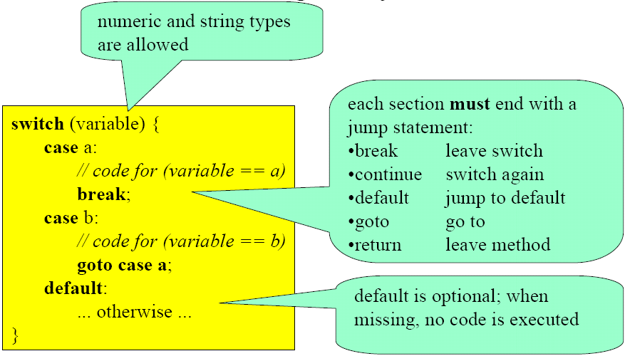
Switch Case in C#

Slide 9
Switch Case
Every statement sequence in a case must be terminated with break (or return, goto, throw).
Type of the switch expression
  integer type,
  char,
  string, or
  null
Note: "double" type is not allowed.

Slide 10
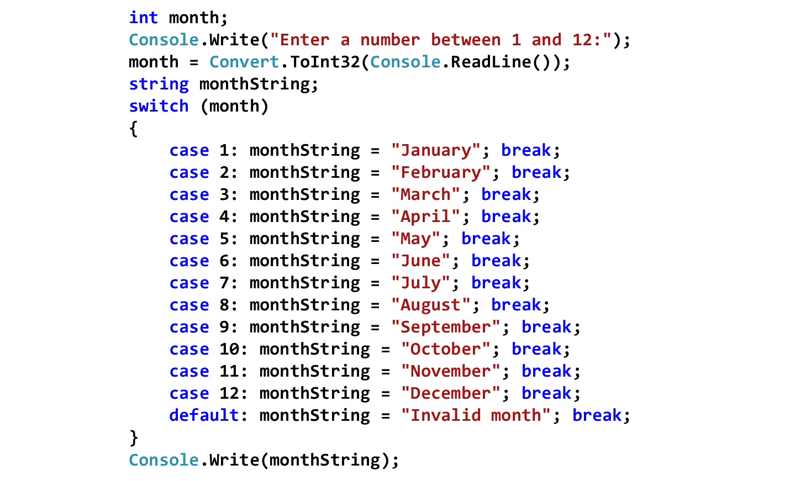
Switch Case Example
Write a program that displays the name of the month, based on the value of month.

Slide 11
Switch Case Example
switch (country) {
case "England": case "USA":
language = "English";
break;
case "Germany": case "Austria": case "Switzerland":
language = "German";
break;
case null:
Console.WriteLine("no country specified");
break;
default:
Console.WriteLine("don't know the language of " + country);
break;
}

Slide 12
Using switch-case OR if-else
An if-else statement can be used to make decisions based on ranges of values or conditions.
  Example: if (x > y)
  if ((x>10) & (x<20))
Whereas a switch-case statement can make decisions based only on a single integer or enumerated value.
  Example: switch(x)
  case 1: …
  case 2: …

Slide 13
Example
Which one should be used to solve the following problem?
  ″switch-case″ or
  ″if-else″
Write a program that finds the category of a given age.
Age | Category
0 – 3 | Baby
4 – 15 | Child
16 – 34 | Young
35 – … | Adult

Slide 14



Switch-case vs. If-else
Which one is faster?
  Test 1: http://www.blackwasp.co.uk/SpeedTestIfElseSwitch.aspx
    One billion (1,000,000,000) iterations
    A random generated integer was compared using if and case statements.
  Test 2: http://www.ashishpaliwal.com/blog/2009/08/if-else-vs-switch-%E2%80%93-which-is-better/
  Result: The switch statement is faster to execute than if-else-if ladder. This is due to the compiler's ability to optimise the switch statement.

Slide 15
int x = 0;
Console.Write("Enter Choice to Perform Operation: "); x = Convert.ToInt32(Console.ReadLine()); switch (x)
{ case 1:
System.Diagnostics.Process.Start("Notepad"); break; case 2:
System.Diagnostics.Process.Start("Calc"); break; case 3:
System.Diagnostics.Process.Start("Mspaint"); break; default:
Console.WriteLine("Please Enter Choice between 1 to 3,Try Again!!!"); break;
}
Example

